Slide 1
Daemon Set
Ow

Slide 2
Daemon Set
A DaemonSet ensures that all nodes run a copy of a Pod
As nodes are added in cluster, Pods are added to them
As nodes are removed from the cluster, those Pods are garbage collector
Uses are DaemonSet
Running any log collection tool
Running node monitoring tools

Slide 3
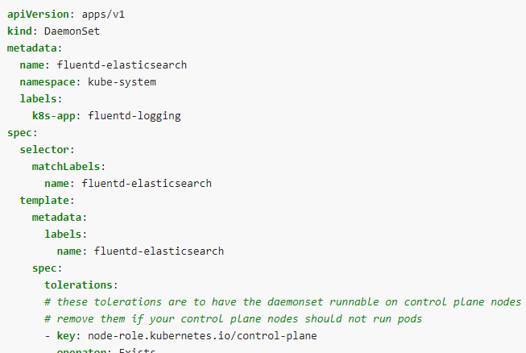
DameonSet Spec

Slide 4
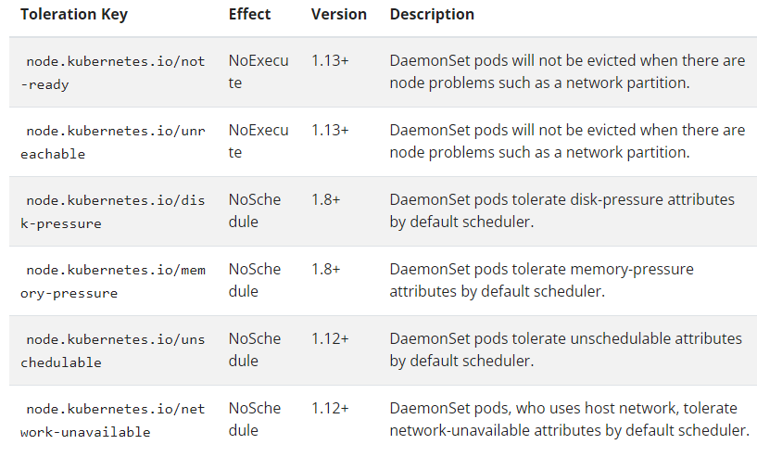
toleration

Slide 5
DaemonSet Update Strategy
DaemonSet has two update strategy types:
OnDelete: With OnDelete update strategy, after you update a DaemonSet template, new DaemonSet pods will only be created when you manually delete old DaemonSet pods. This is the same behavior of DaemonSet in Kubernetes version 1.5 or before.
RollingUpdate: This is the default update strategy.With RollingUpdate update strategy, after you update a DaemonSet template, old DaemonSet pods will be killed, and new DaemonSet pods will be created automatically, in a controlled fashion. At most one pod of the DaemonSet will be running on each node during the whole update process

